Slide 1



SESSION NAME HERE
String Handling

Slide 2


Data Science Lecture Housekeeping
The use of disrespectful language is prohibited in the questions, this is a supportive, learning environment for all - please engage accordingly. (FBV: Mutual Respect.)
No question is daft or silly - ask them!
There are Q&A sessions midway and at the end of the session, should you wish to ask any follow-up questions. Moderators are going to be answering questions as the session progresses as well.
If you have any questions outside of this lecture, or that are not answered during this lecture, please do submit these for upcoming Open Classes. You can submit these questions here: Open Class Questions

Slide 3
Data Science Lecture Housekeeping cont.
For all non-academic questions, please submit a query: www.hyperiondev.com/support
Report a safeguarding incident: www.hyperiondev.com/safeguardreporting
We would love your feedback on lectures: Feedback on Lectures

Slide 4


A brief recap on Strings and String Methods.
Examples of some more advanced cases of String manipulation / handling.
Lecture Objectives

Slide 5

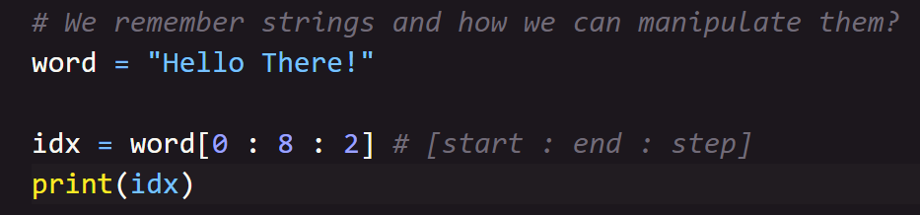
Remembering Strings

Slide 6
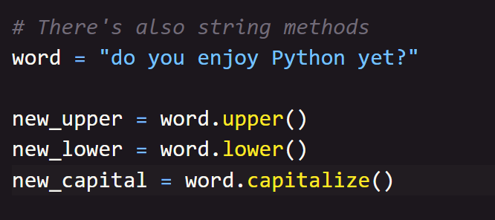
Remembering Strings

Slide 7
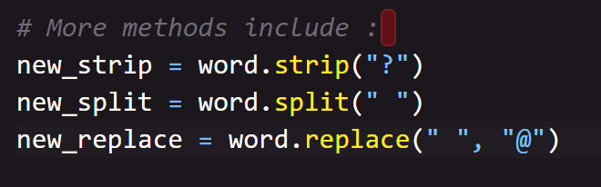
Remembering Strings

Slide 8
Formatting Strings
Instead of simply concatenating strings together, we have the ability to create more complex, formatted strings. With the power of this method we are able to create formatted strings by placing variables into placeholders.

Slide 9
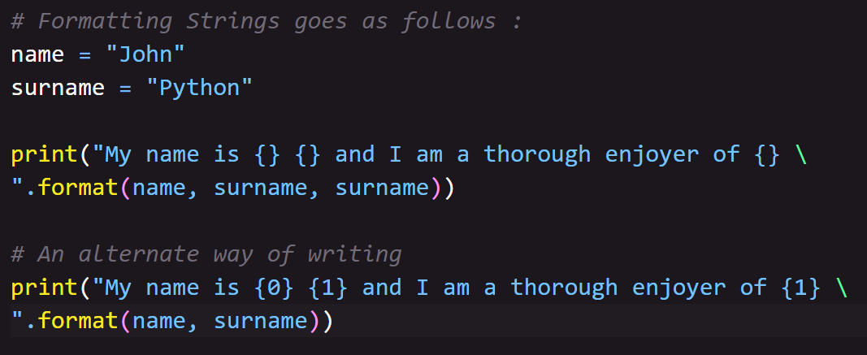
Formatting Strings

Slide 10
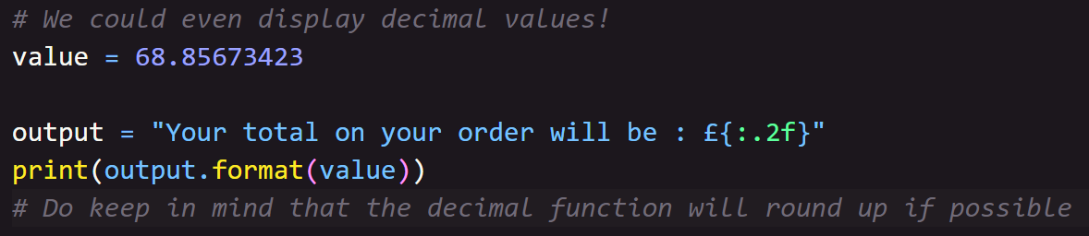
Format Examples

Slide 11
F-Strings
There is another means to format strings that was introduced, which is called Literal String Interpolation, or better known as f-strings.

Slide 12
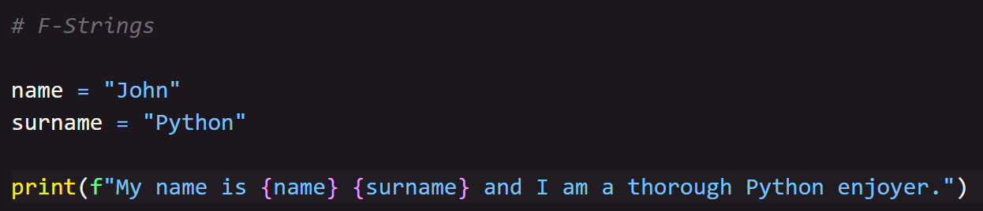
F-String Example

Slide 13

Q & A SECTION
Please use this time to ask any questions relating to the topic, should you have any.

Slide 14

Thank you for joining!

